Slide 1
Forensic Analysis Case Phase 4
By Wendel Jackson
CIST 2612

Slide 2
Overview
A Windows 11 system was analyzed after suspicious activity
Evidence collected:
Disk image
Memory dump
Suspicious downloaded files was identified
System showed unusual program activity

Slide 3
Scope
The scope is a Logical Image of the Downloads folder on the Windows 11 system and memory dump collected from the host computer.
Disk Image: Image.ad1
Memory dump: physmem.raw
Due to storage limitations the Logical Image contains the data only from the Downloads directory.

Slide 4
Acquisition
A Kali Linux virtual machine on Oracle VirtualBox was used to analyze the data. Multiple tools were used including Autopsy, Volatility, FTK Imager, and WinPmem.
The evidence collected from the host machine was:
Logical Image of the Downloads folder created using FTK Imager and analyzed with Autopsy.
Memory Dump obtained using WinPmem and analyzed with Volatility.

Slide 5
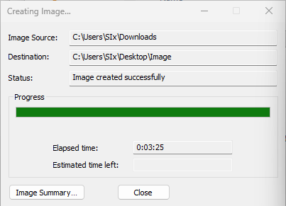
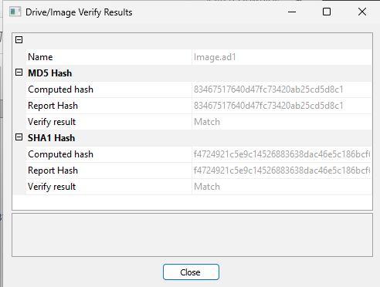
FTK Imager

Slide 6
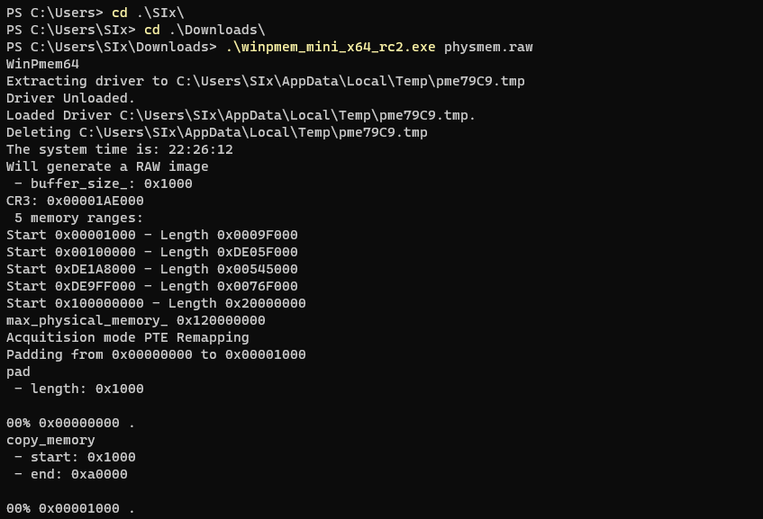
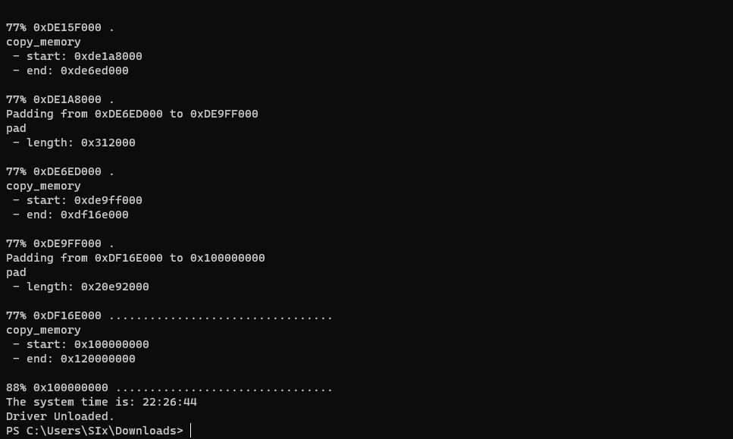
WinPmem

Slide 7
Chain of Custody
Evidence ID: 1
Description: Disk Image
Date/Time Acquired 4/28/26 3:34 PM EST
Hash: ccc45b5e0c1bc1d2e29ff83a2ba72ec4544db1ebb58d1146ce6ee2aa8d14bdfc
Storage Location: /home/wendel/evidence/Image.ad1
Acquired using FTK Imager
Evidence ID: 2
Description: Memory Dump
Date/Time Acquired 4/28/26 3:26 PM EST
Hash: b49d6bd310164c45824f09a272140918ebbc6b8ebc12646bc42770ed526ecfd7
Storage Location: /home/wendel/evidence/physmem.raw
Acquired using WinPmem

Slide 8
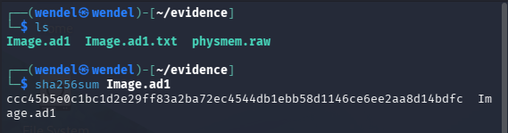
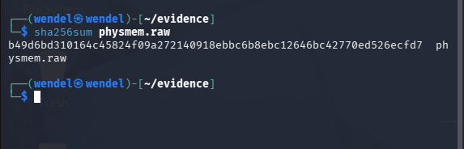
Disk and Memory Storage & Hashing
After creation, the files were transferred into the secure folder and hashed with sha256.

Slide 9
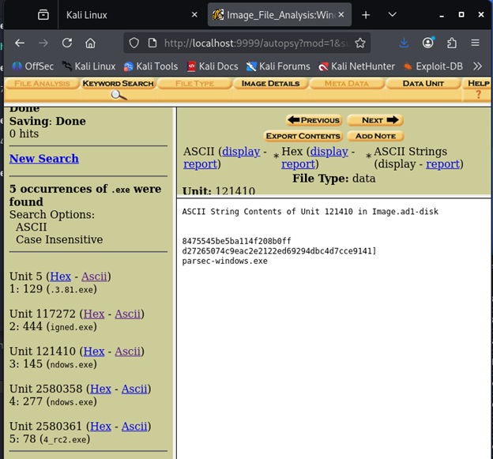
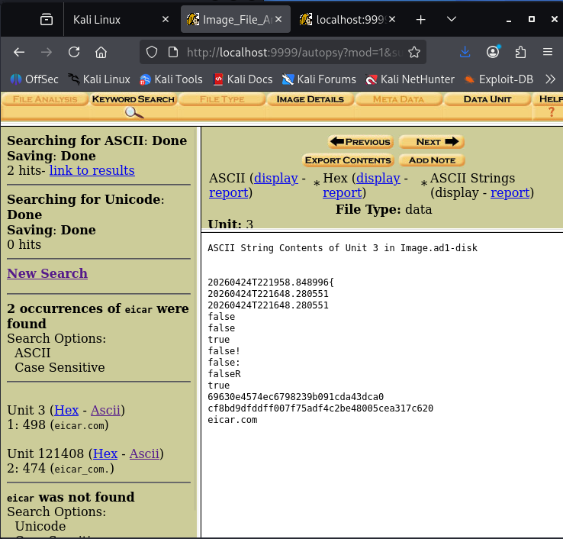
Image Evidence
The Image.ad1 file was analyzed in Autopsy and files were found.

Slide 10
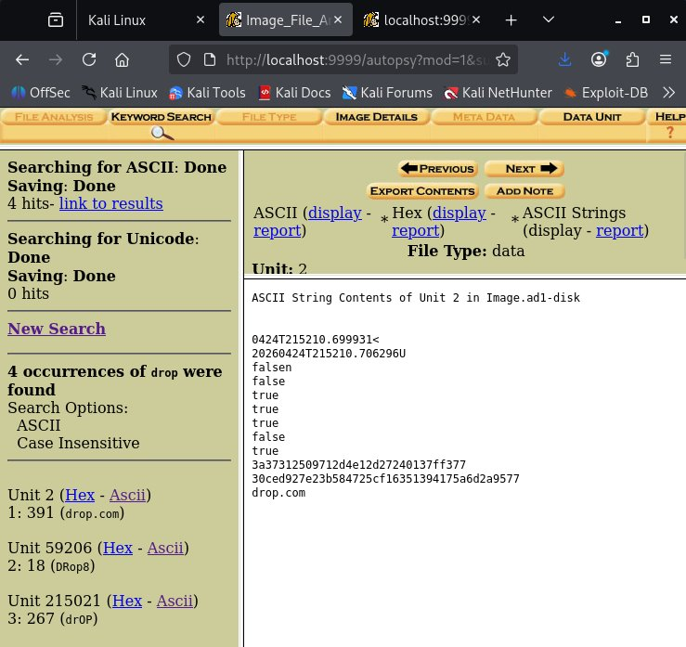
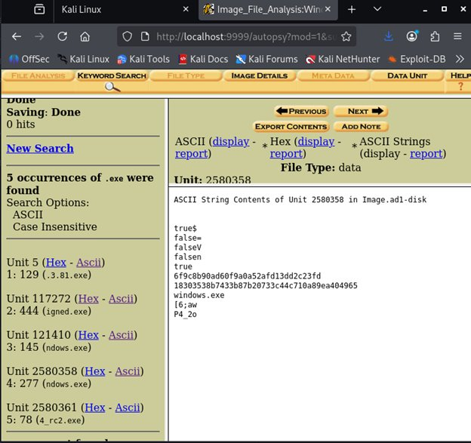

Slide 11
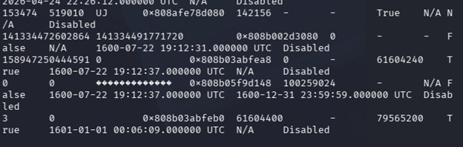

Memory Data Evidence
Using volatility3 commands the physmem.raw file was analyzed and a few unknown programs were found running.
Example

Slide 12
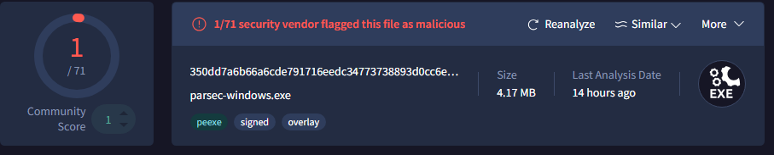
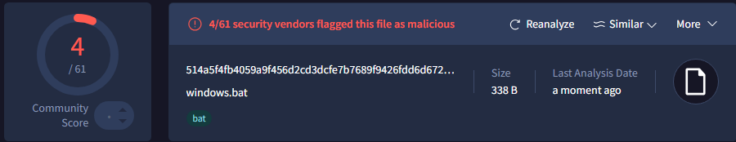
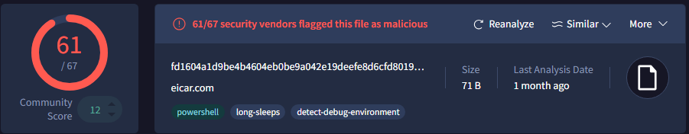
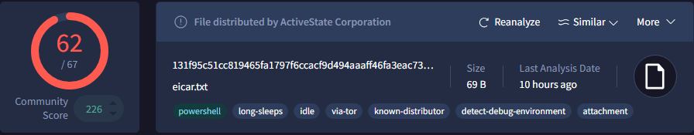
Addition Evidence
After finding the .exe files that were present in the folder, I went to a website called VirusTotal and performed a scan on the files. Multiple of them were flagged as malicious.

Slide 13
Timeline
Prior to acquisition the files were downloaded.
4/28/26 3:34 PM EST – Disk image created
4/28/26 3:26 PM EST – Memory Dump created
4/28/26 6:06-6:11 PM EST – Volatility used to analyze the memory dump file, discovering unknown files
4/29/26 5:18-5:31 PM EST – parsec-windows.exe, eicar.com, drop (eicar.txt), and windows.bat identified in Autopsy
4/29/26 5:35-5:37 PM EST - Identified files scanned with VirusTotal

Slide 14
Conclusion
This investigation concluded that the system may have been compromised after downloading the parsec-windows.exe or one of the other files from the internet.
The VirusTotal Flags and presence of unknown processes running lead to this conclusion.

